Slide 1

Black Box Test Design Techniques

Slide 2

Agenda
Overview of Blackbox techniques
Equivalence Class
Boundary Value Analysis
State Transition Technique

Slide 3
Overview of Black Box testing
What is Black box Testing?
Black-box testing is a method of software testing that examines the functionality of an application based on the specifications. It is also known as Specifications based testing. Independent Testing Team usually performs this type of testing during the software testing life cycle.
This method of test can be applied to each level of software testing such as unit, integration, system and acceptance testing

Slide 4
Behavioural Testing Techniques
Equivalence Class |  | Equivalent Class Partitioning is a black box technique (code is not visible to tester) which can be applied to all levels of testing like unit, integration, system, etc. In this technique, you divide the set of test condition into a partition that can be considered the same
Boundary Value Analysis |  | Boundary testing is the process of testing between extreme ends or boundaries between partitions of the input values. So these extreme ends like Start- End, Lower- Upper, Maximum-Minimum, Just Inside-Just Outside values are called boundary values and the testing is called "boundary testing".
State Transition Technique |  | State transition testing is a black box testing technique and is used where some aspect of the system can be described in what is called a “finite state machine”.
Decision Table |  | Decision table testing is a software testing technique used to test system behavior for different input combinations. This is a systematic approach where the different input combinations and their corresponding system behavior (Output) are captured in a tabular form.

Slide 5
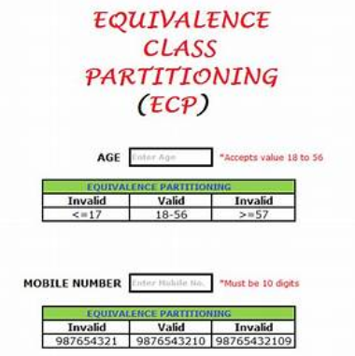
Example Explanation for Equivalence partitioning Testing

Slide 6
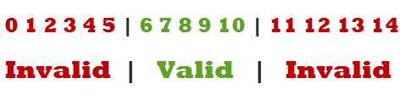
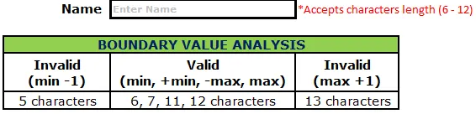
Example Explanation for Boundary Value Analysis

Slide 7
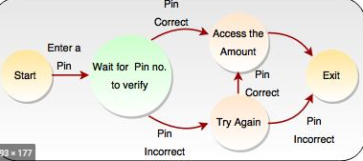
Example Explanation for state transition testing

Slide 8
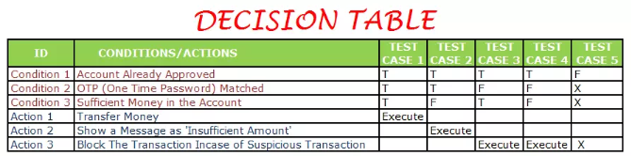
Example Explanation for Decision table

Slide 9
Questions ?

